Slide 1




NEXT GEN EMPLOYABILITY PROGRAM
Creating a future-ready workforce
Team Members
College Name
Student Name : Ashley Nivedha J
Student ID : au311121104011
Loyola-ICAM College of Engineering and Technology

Slide 2

CAPSTONE PROJECT SHOWCASE
Project Title
MUSIC WEB APPLICATION USING DJANGO FRAMEWORK
Abstract | Problem Statement | Project Overview | Proposed Solution | Technology Used | Modelling & Results | Conclusion

Slide 3
Abstract
The Music Web Application using Django is a web-based platform designed to provide users with a seamless experience for discovering and enjoying music. Built on the Django framework, the application offers features such as user registration and authentication, allowing users to create personalized accounts. Additionally, users can search for songs, listen to audio tracks, and save their favorite songs to a watch later list. With its user-friendly interface and robust functionality, the app aims to elevate the music listening experience for users.
Source :

Slide 4
Problem Statement
To develop a Music Web Application using the Django framework to allow users to search for songs, listen to them, and add them to their watch later list. The application should provide features such as user registration, authentication, and the ability to add songs to a watch later list. Additionally, users should be able to view their watch later list and remove songs from it. The application should have an intuitive and user-friendly interface, ensuring a seamless experience for users interacting with the platform.
Source :

Slide 5
Project Overview
The Music Web Application using Django is a platform developed to facilitate users in exploring, listening to, and managing their favorite songs. Leveraging the Django framework, the application offers features such as user authentication, song search functionality, and a watch later list. The intuitive interface and comprehensive functionality of the app aim to enhance the music listening experience for users
Source :

Slide 6
Proposed Solution
.
User Authentication: Implement a user registration and authentication system to allow users to create accounts, log in securely, and access personalized features.
Song Management: Develop functionality for users to search for songs based on title, browse through a collection of available songs, and listen to audio tracks directly on the platform.
Watch Later List: Introduce a feature that enables users to add songs to a watch later list for future reference, allowing them to curate a personalized collection of favorite tracks.
Source :

Slide 7
4. Responsive Design: Ensure that the application is responsive and compatible with various devices and screen sizes, providing a seamless user experience across desktop, tablet, and mobile platforms.
5.Scalability and Performance: Design the application architecture to be scalable and capable of handling a growing number of users and songs efficiently. Optimize performance to deliver fast response times and smooth playback of audio tracks.
Source :

Slide 8


Technology Used
Front-end
Back-end
Source :

Slide 9
Modelling & Results
Database Model: Utilize Django's built-in ORM (Object-Relational Mapping) to define models for storing essential data such as songs, user profiles, and watch later lists.
Song Model: Define a model to represent songs, including attributes such as title, artist, and audio file URL. This model facilitates the storage and retrieval of song-related information.
User Profile Model: Create a model to extend Django's default User model, allowing for additional user-related data such as the watch later list.
Watch Later Model: Implement a model to establish a many-to-many relationship between users and songs, enabling users to add songs to their watch later list and retrieve them as needed.
Database Schema: Design an efficient database schema to support the storage and retrieval of data, considering factors such as normalization, indexing, and performance optimization.
Source :

Slide 10
Data Persistence: The application effectively stores and retrieves song data, user profiles, and watch later lists from the database, ensuring data integrity and reliability.
User Interaction: Users can interact with the application to search for songs, play audio tracks, register/login securely, and manage their watch later lists, enhancing the overall user experience.
Performance: The optimized database schema and efficient querying mechanisms contribute to fast response times and smooth playback of audio tracks, enhancing the application's performance.

Slide 11
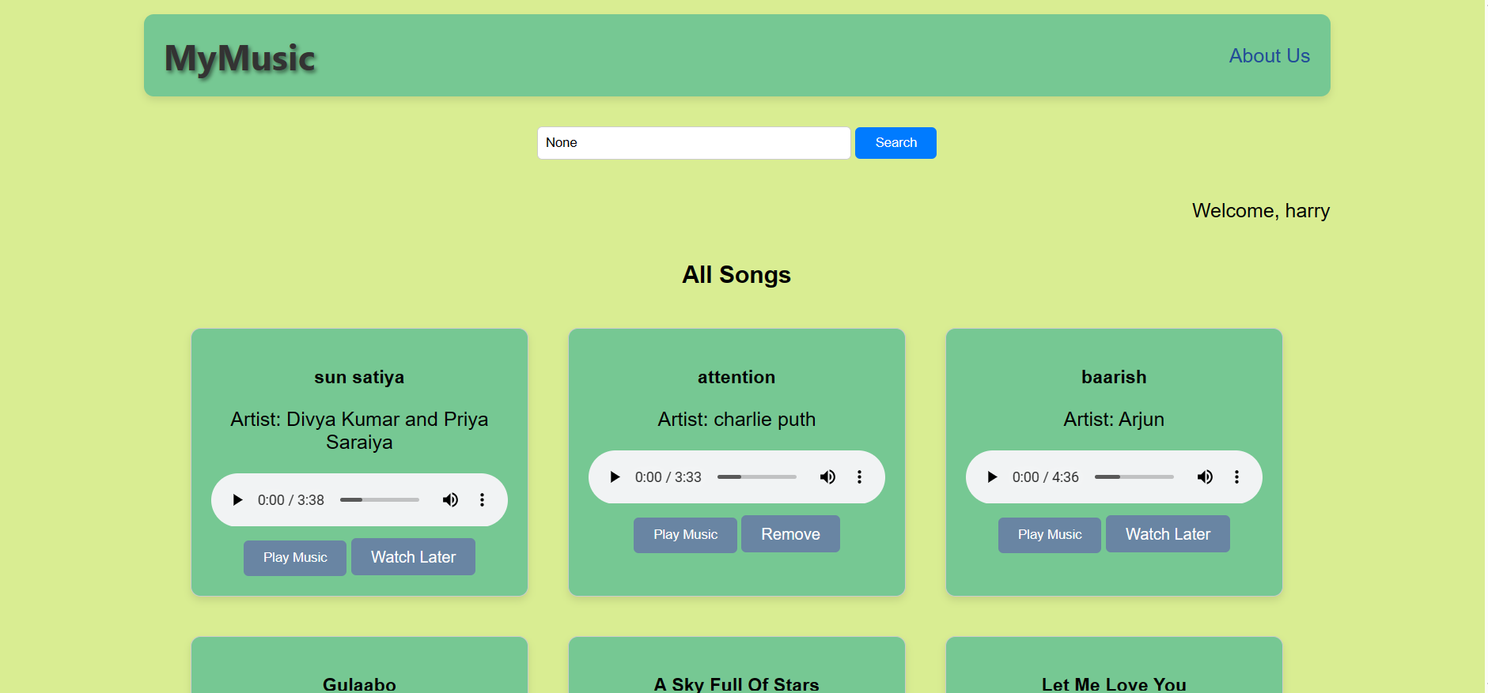
Homepage

Slide 12
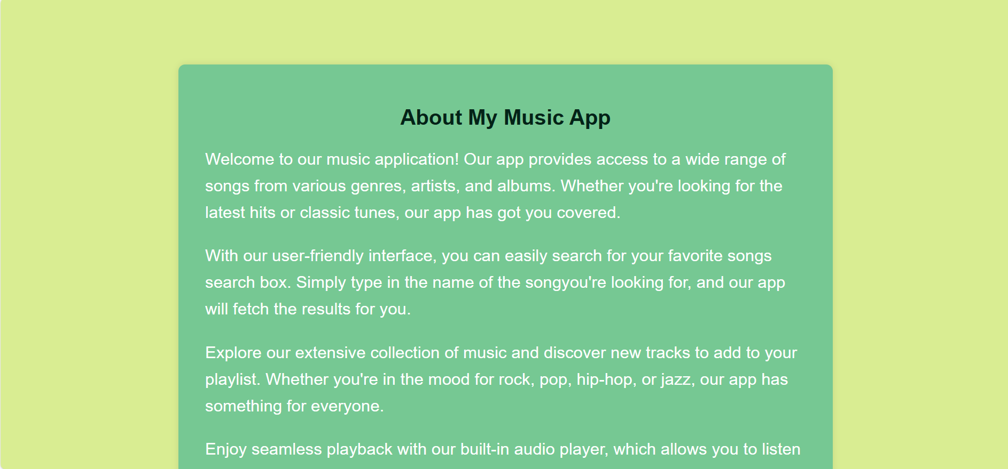
About-Us-Page

Slide 13
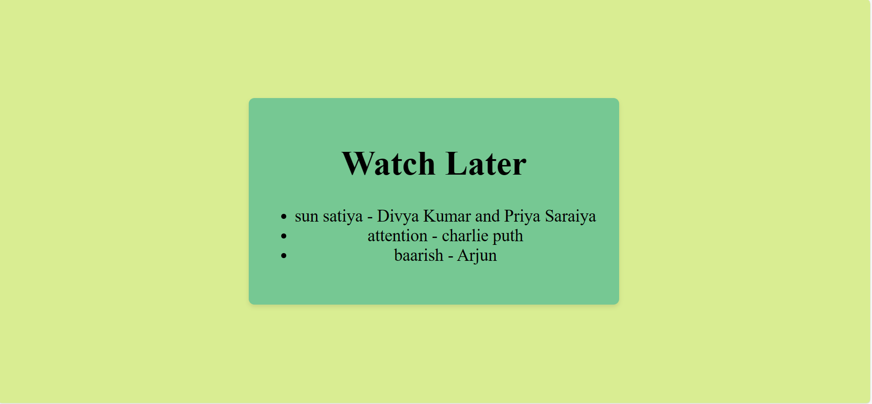
Watch Later

Slide 14
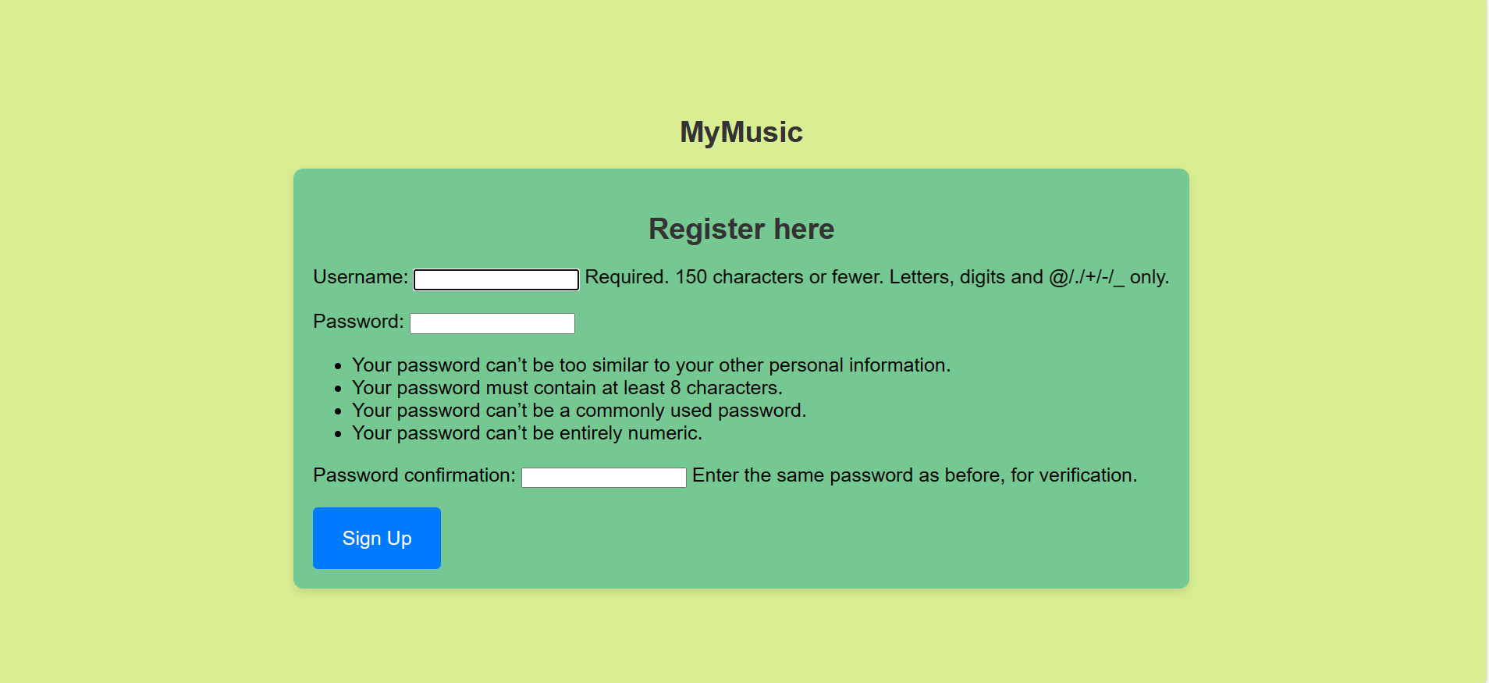
Register page

Slide 15
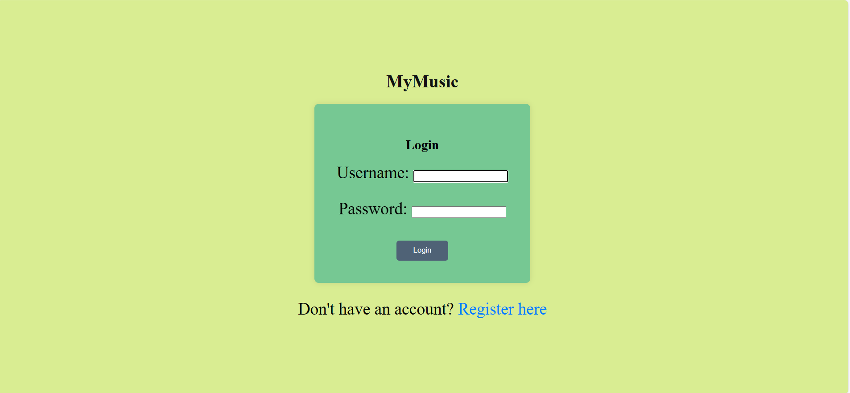
Login page

Slide 16
Future Enhancements:
Some potential future enhancements for the Music Web Application using Django:
1. User Profiles: Enhance user profiles with additional features such as profile pictures, user bio, and social media integration.
2. Playlist Management: Implement functionality for users to create and manage custom playlists, allowing them to organize songs based on their preferences and moods.
3. Recommendation System: Integrate a recommendation system that suggests songs to users based on their listening history, favorite genres, and user interactions.
4. Social Features :Incorporate user following, playlist sharing, and commenting on songs to promote user engagement and community interaction.
5. Mobile App Development: Extend the application's reach by developing native mobile apps for iOS and Android platforms, offering users a seamless music listening experience on their mobile devices.

Slide 17
Conclusion
The Music Web Application, constructed using the Django framework, provides users with a smooth interface for discovering, listening to, and organizing their preferred music selections. Leveraging Django's robust capabilities, the platform delivers essential features like user authentication, search functionalities, and the ability to bookmark songs for later viewing. Although there were challenges in database design and integrating audio playback functions, these issues were effectively resolved during development. Looking forward, there are opportunities for refinement, including improving user profiles, introducing playlist management features, integrating recommendation systems, enabling social interactions, and extending support to mobile platforms. These upgrades aim to enhance user satisfaction and broaden the application's reach. In summary, the Music Web Application showcases Django's versatility and effectiveness in crafting sophisticated web solutions, paving the way for future enhancements to meet the evolving demands of music enthusiasts globally.
Source :

Slide 18
Thank You!
Notes:
Thank You !!

